Slide 1
Introduction to DevOps
Sonika Rathi
Assistant Professor
BITS Pilani

Slide 2
Agenda
Agile Methodology
Software Development Life Cycle
Waterfall Model & its Amendment
Need of Agile
Agile Methodology
Principles of Agile Methodology
Pillars of Agile Methodology
Agile Methodologies
Roles in Agile

Slide 3
Software Development Life Cycle
SDLC Phases
Requirement Analysis
Design
Development
Testing
Release
Maintenance
Feedback

Slide 4
Waterfall Model
Intorduction
It is also called as the classic life cycle
Waterfall Model is considered as Black Box Model
One can not go back to previous phase
Sequential in Nature
This suggests a systematic, sequential approach to software development that begins with customer specification of requirements
And progresses through
Planning
Modeling
Construction
Deployment
and Culminating in ongoing support of the completed software

Slide 5
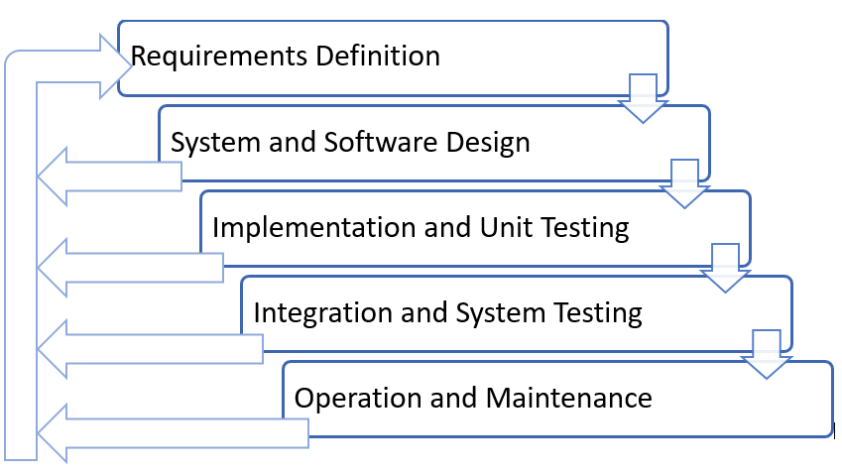
Waterfall Model Contd..
Feedback Amendment in Waterfall Model

Slide 6
Waterfall Model Contd..
Advantages
Easy to use and follow
Cost effective
Each phase completely developed
Development processed in sequential manner, so very less chance of rework
Easy to manage the project
Easy documentation

Slide 7
Waterfall Model Contd..
Waterfall Model Problems
The main drawback of the waterfall model is the difficulty of accommodating change after the process is underway
In principle, a phase has to be complete before moving onto the next phase
Inflexible partitioning of the project into distinct stages makes it difficult to respond to changing customer requirements
Therefore, this model is only appropriate when the requirements are well-understood and changes will be fairly limited during the design process
Few business systems have stable requirements

Slide 8
Need of Agile
Why Agile?
The project will produce the wrong product
The project will produce a product of inferior quality
The project will be late
We’ll have to work 80 hour weeks
We’ll have to break commitments
We won’t be having fun
Storm called Agile
According to VersionOne's State of Agile Report in 2017 says 94% of organizations practice Agile, and in 2018 it reported 97% organizations practice agile development methods

Slide 9
Agile Methodology Contd..
Agile – Background
Agile was formally launched in 2001
17 technologists drafted the Agile Manifesto
Kent Beck
Mike Beedle
Ken Schwaber
Jeff Sutherland
Dave Thomas
Arie van Bennekum
Alistair Cockburn
Ward Cunningham
Martin Fowler
James Grenning
Jim Highsmith
Andrew Hunt
Ron Jeffries
Jon Kern
Brian Marick
Robert C. Martin
Steve Mellor

Slide 10
Principles of Agile Methodology
Twelve Principles
Our highest priority is to satisfy the customer through early and continuous delivery of valuable software
Welcome changing requirements, even late in development. Agile processes harness change for the customer's competitive advantage
Deliver working software frequently, from a couple of weeks to a couple of months, with a preference to the shorter timescale
Business people and developers must work together daily throughout the project
Build projects around motivated individuals. Give them the environment and support they need, and trust them to get the job done
The most efficient and effective method of conveying information to and within a development team is face-to-face conversation
Working software is the primary measure of progress
Agile processes promote sustainable development. The sponsors, developers, and users should be able to maintain a constant pace indefinitely
Continuous attention to technical excellence and good design enhances agility
Simplicity--the art of maximizing the amount of work not done--is essential
The best architectures, requirements, and designs emerge from self-organizing teams
At regular intervals, the team reflects on how to become more effective, then tunes and adjusts its behavior accordingly

Slide 11
Pillars of Agile Methodology
Agile focuses on
Individuals and interactions
Processes and tools
Working software
Comprehensive documentation
Customer Collaboration
Contract negotiation
Responding to change
Following a plan

Slide 12
Agile Methodologies
Few of Agile Methodologies
Scrum
Extreme Programming [XP]
Test driven Development [TDD]
Feature Driven Development [FDD]
Behavior-driven development [BDD]

Slide 13
Roles in Agile
Basic roles involved
User
Product Owner
Software Development Team

Slide 14
Reference
https://explore.versionone.com/state-of-agile/

Slide 15
Thank You!
In our next session:

